Slide 1
Thermal runaway
Qref
alpha=4.28*10**-17
flu1= 1.0*10**16 #fluence
flu2= 2.1*10**16
flu3= 3.0*10**16
h=4.4 #width of the sensor
l=1.8 #lenght of the sensor
dd=130*10**-4 #depletion depth
Vb=600 #bias voltage
Tr=293 #reference Temperature
Ta=7000 #Activation Temperature
T0=253
# Qref
Qr1=alpha*flu1*h*l*dd*Vb
Qr2=alpha*flu2*h*l*dd*Vb
Qr3=alpha*flu3*h*l*dd*Vb

Slide 2
Thermal runaway numbers
Qref(T=20C, Fluence = 1e16) = 26.44 W
Qref(T=20C, Fluence = 2e16) = 55.52 W
Qrer(T=20C, Fluence = 3e16) = 79.32 W
T(K) | Q1(W) | Q2(W) | Q3(W)
240 | 0.090712 | 0.190495 | 0.272136
241 | 0.103237 | 0.216798 | 0.309711
242 | 0.117370 | 0.246478 | 0.352111
243 | 0.133302 | 0.279934 | 0.399906
244 | 0.151243 | 0.317611 | 0.453730
... | ... | ... | ...
298 | 40.836517 | 85.756686 | 122.509551
299 | 44.471055 | 93.389216 | 133.413165
300 | 48.402634 | 101.645532 | 145.207902
301 | 52.653315 | 110.571961 | 157.959945
302 | 57.246626 | 120.217915 | 171.739878
Note that at room temperature (~298K):
sensor will be in thermal runaway already
Q is too high to be extracted by cooling system

Slide 3
How to mimic thermal runaway at room temperature?
Ts | Ts_e | Q1 | Q2 | Q3
240 | 293 | 0.090712 | 0.190495 | 0.272136
241 | 294 | 0.103237 | 0.216798 | 0.309711
242 | 295 | 0.117370 | 0.246478 | 0.352111
243 | 296 | 0.133302 | 0.279934 | 0.399906
244 | 297 | 0.151243 | 0.317611 | 0.453730
... | ... | ... | ... | ...
298 | 351 | 40.836517 | 85.756686 | 122.509551
299 | 352 | 44.471055 | 93.389216 | 133.413165
300 | 353 | 48.402634 | 101.645532 | 145.207902
301 | 354 | 52.653315 | 110.571961 | 157.959945
302 | 355 | 57.246626 | 120.217915 | 171.739878
Use a heater and map Q from low T range to high T range : i.e.
Translate “original temperature range” to a “room temperature range” while keeping Q the same
This way, cooling the Si sensor at 240 K corresponds to cooling the heater at 293 K and so on. The power produced by the Si sensor and the power dissipated by the heater will be the same for the same change in T

Slide 4
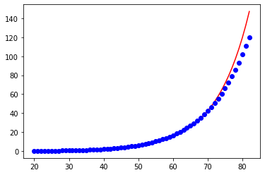
Thermal runaway mimic function
Having the dataset we can fit it and get the parameters
----------fit from curve_fit: y=exp(a+bx) b=0.1036 a=-3.5023
Ts_e | Q1 | Q2 | Q3
293 | 0.090712 | 0.190495 | 0.272136
294 | 0.103237 | 0.216798 | 0.309711
295 | 0.117370 | 0.246478 | 0.352111
296 | 0.133302 | 0.279934 | 0.399906
297 | 0.151243 | 0.317611 | 0.453730
... | ... | ... | ...
351 | 40.836517 | 85.756686 | 122.509551
352 | 44.471055 | 93.389216 | 133.413165
353 | 48.402634 | 101.645532 | 145.207902
354 | 52.653315 | 110.571961 | 157.959945
355 | 57.246626 | 120.217915 | 171.739878
Q(W)
T(C)

Slide 5
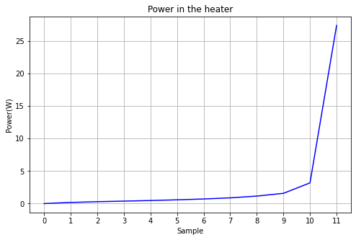
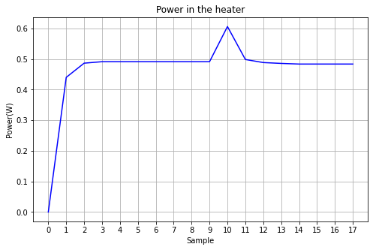
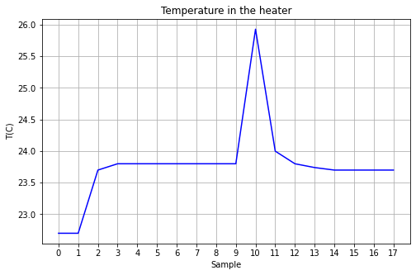
Thermal runaway reproduction
LabView controller power input: P(T)
P=exp(a+bT): b=0.1036; a=-3.5023
TIM
Heater sitting in air:
no TIM
Heater in PPE4 TIM
Heater in PPE4 TIM

Slide 6
Thermal runaway Measurements
Inducing Thermal runaway by changing coolant temperature

Slide 7
Thermal runaway Measurements
Inducing Thermal runaway by changing Fluence

Slide 8
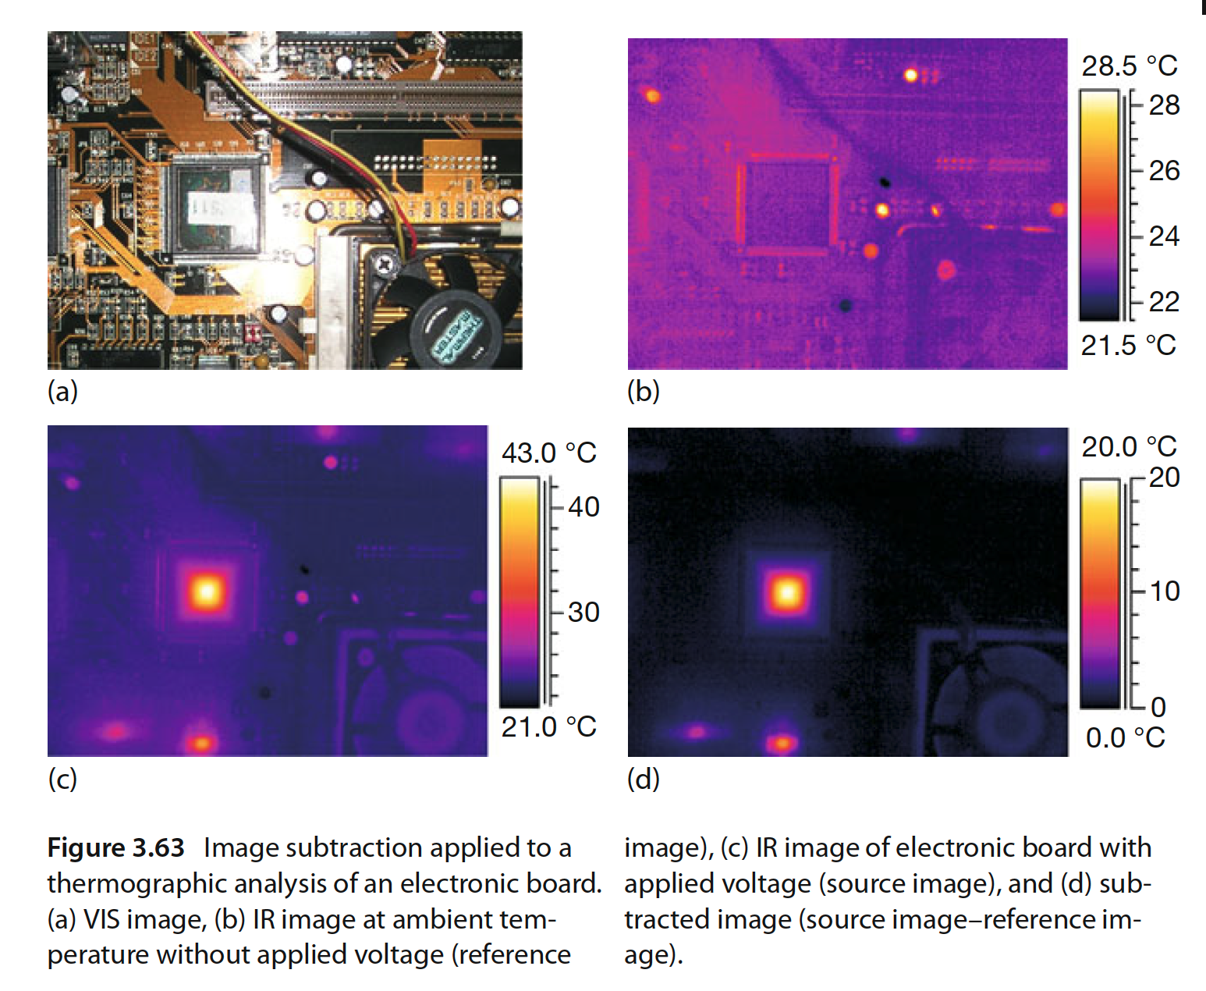
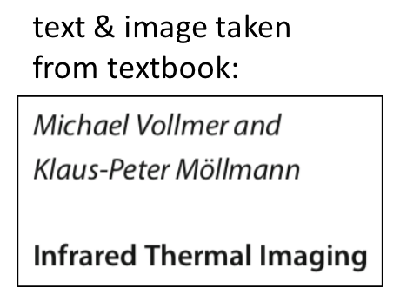
3.5.1.3 Image Subtraction
“Image subtraction can also be used in applications where reflections of ambient
temperature should be suppressed. Figure 3.63 shows an electronic board. From
the visual as well as from the IR image, highly reflecting electronic devices are
clearly seen. If the board is operated, these reflections will add to the emission
of the current-induced self-heated electronic devices. Therefore, the simple IR
image does not allow one to correctly estimate the temperature change under
load.”

